Slide 1
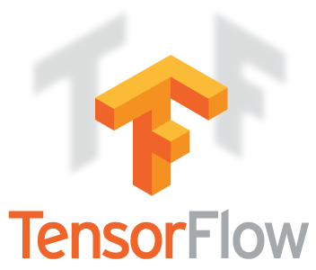

Introduction to TensorFlow and Keras

Slide 2

Agenda
What is deep learning ?

Slide 3
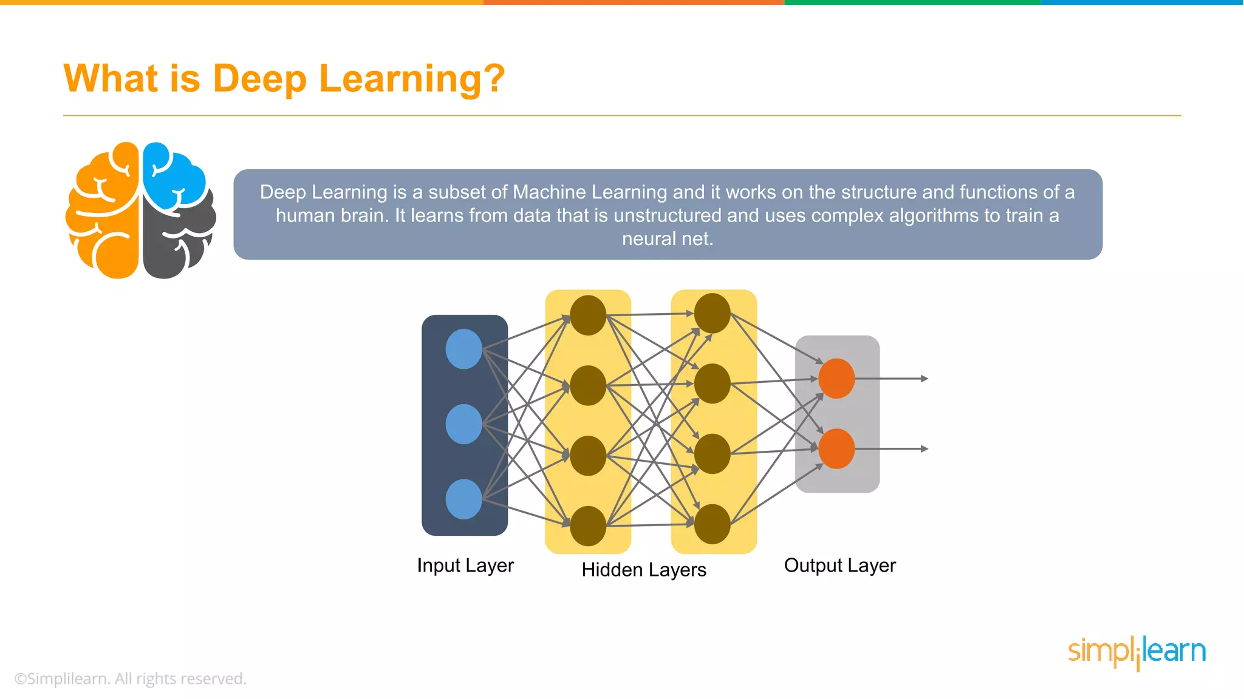

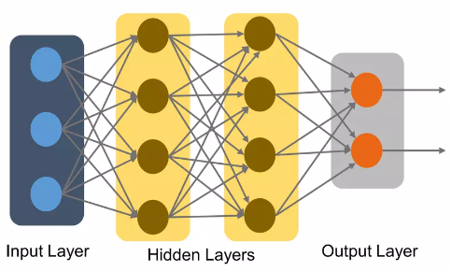



What is deep learning

Slide 4
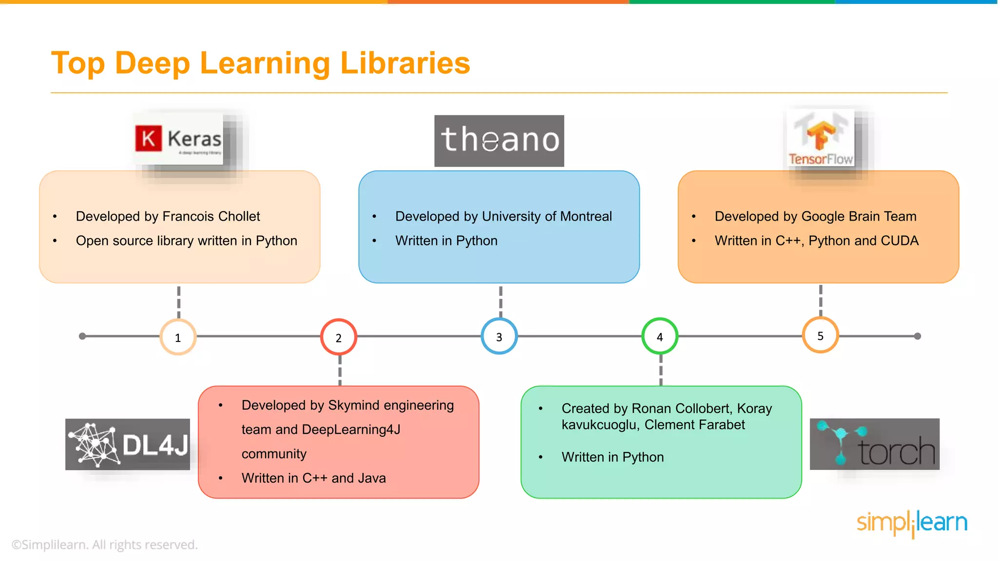

Slide 5
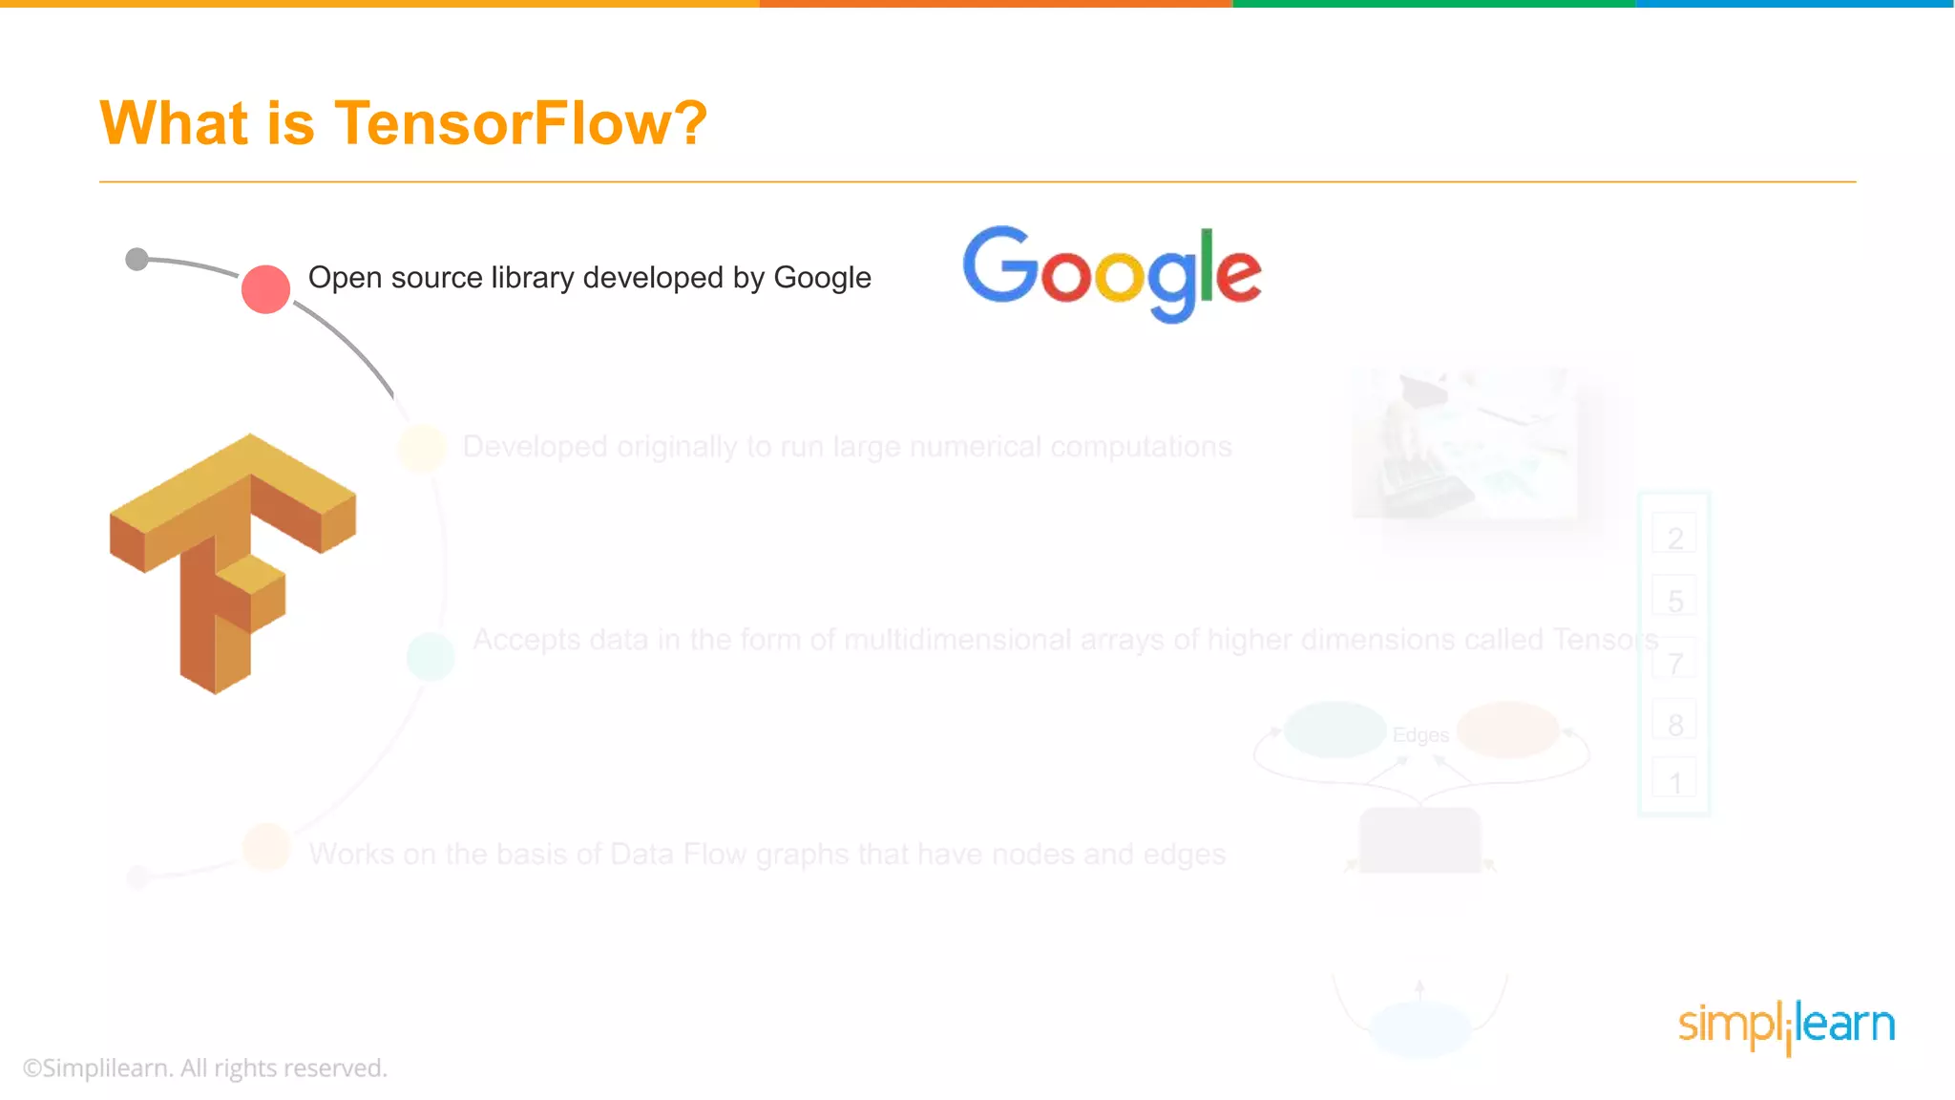

Originally developed by the Google Brain Team within Google’s Machine Intelligence research organization

Slide 6
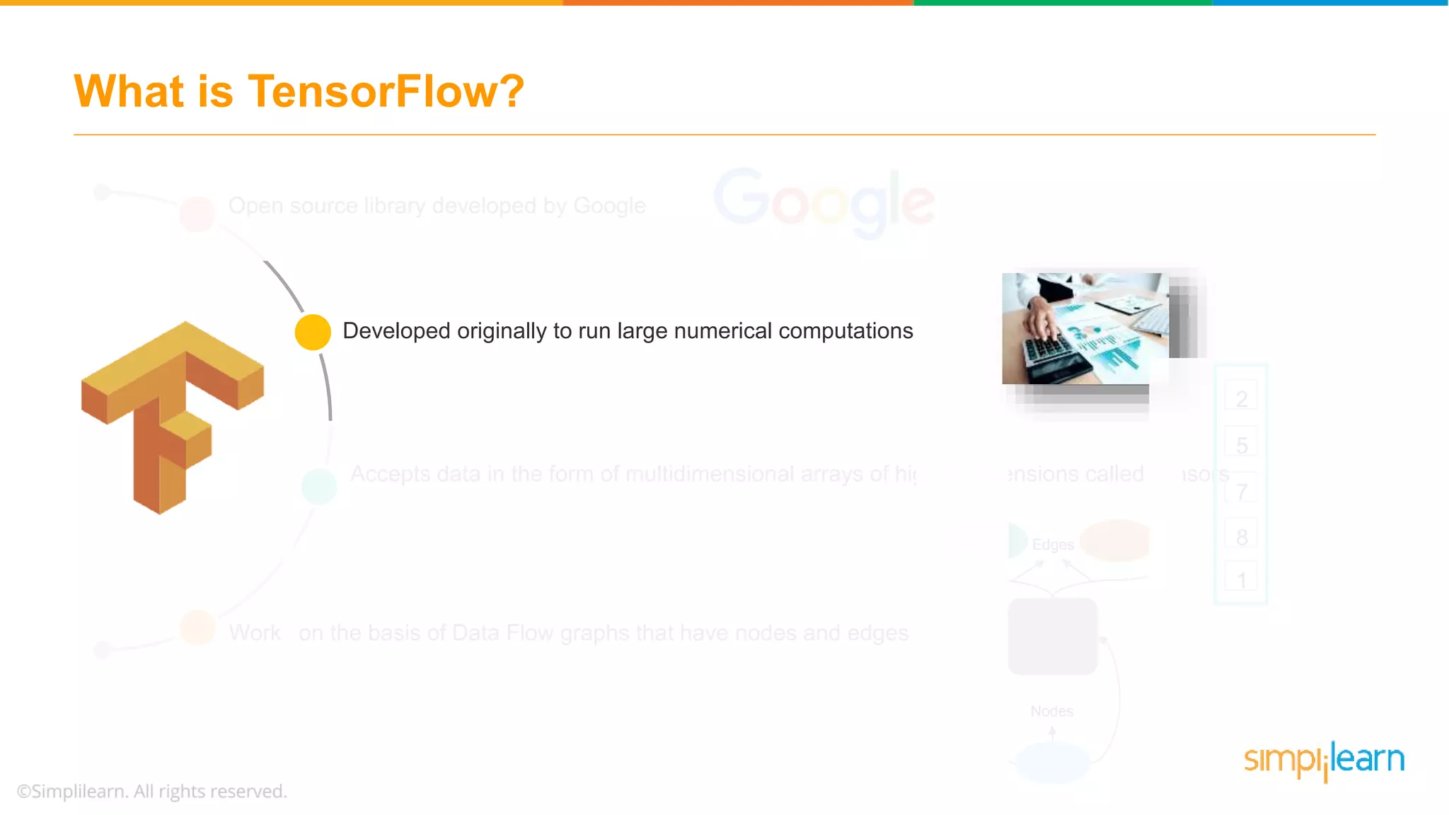

TensorFlow is a deep learning framework adopted both in research and production, originally developed to run large numerical computations

Slide 7
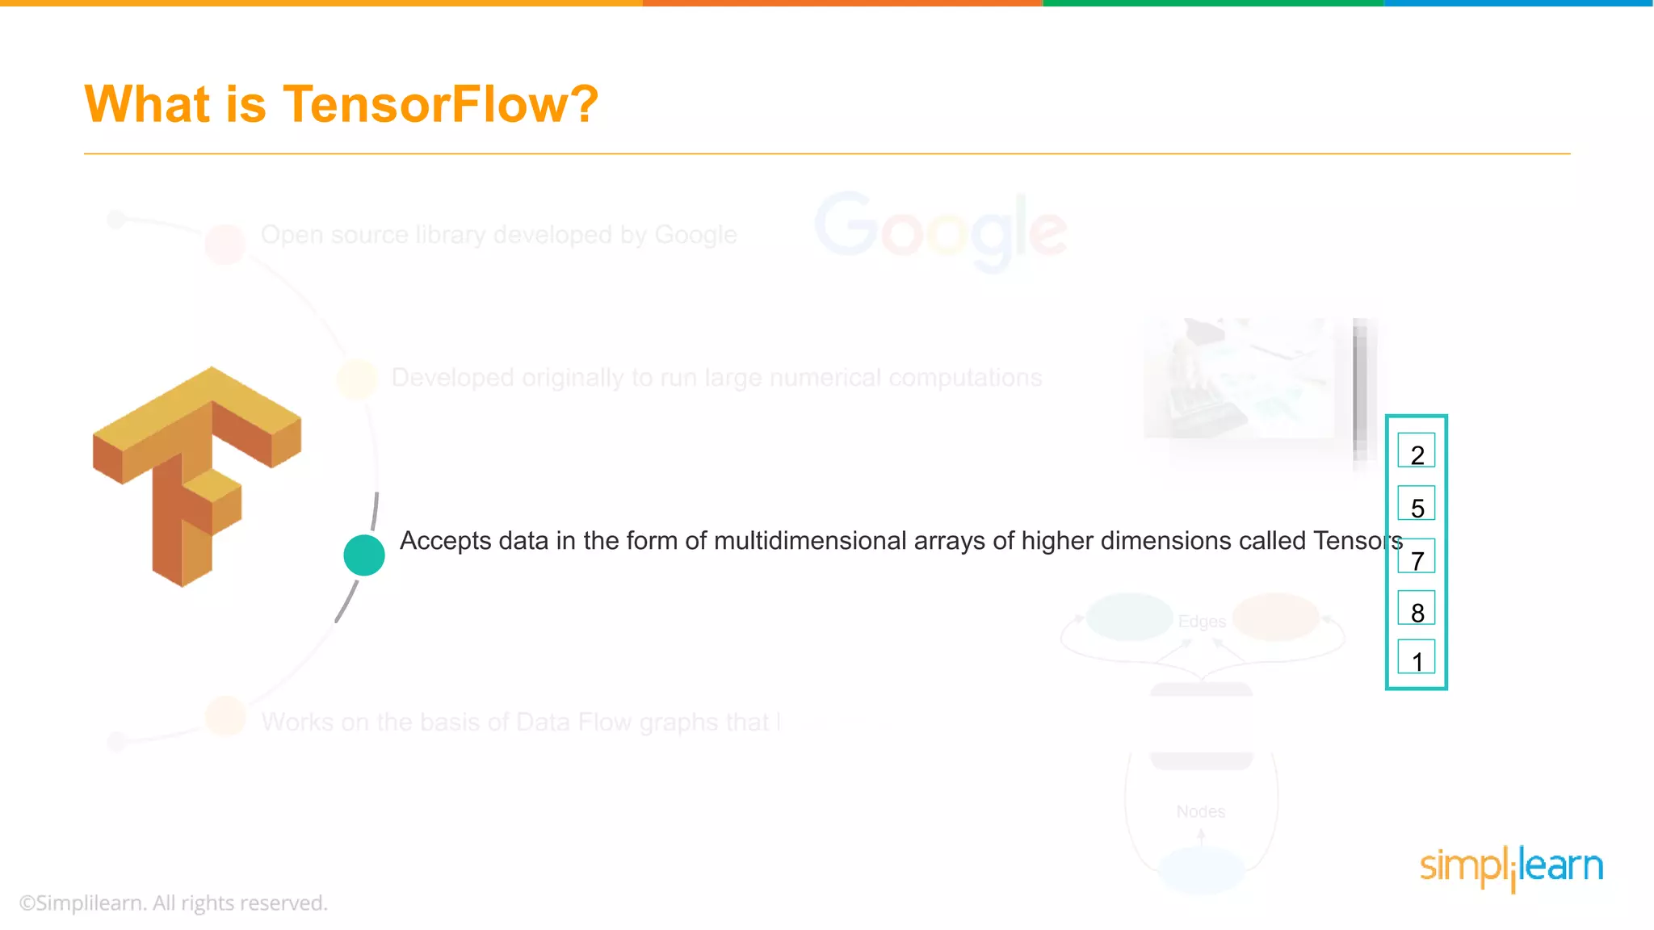
Accepts data in form of multidimensional arrays of higher dimensions called Tensors

Slide 8
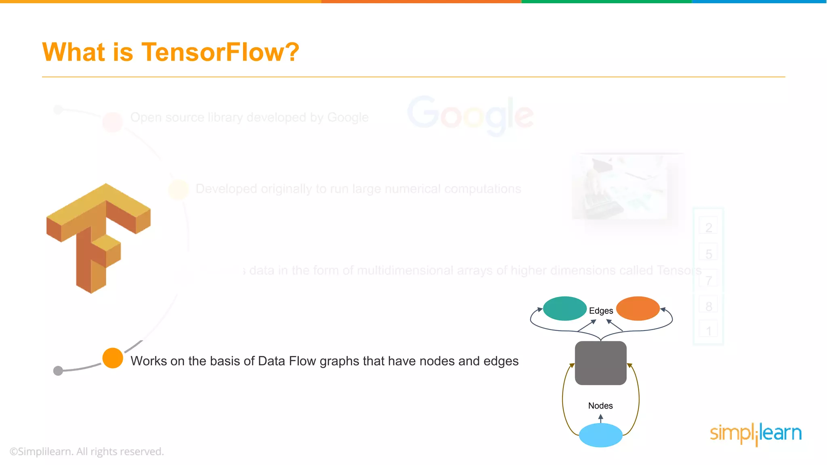
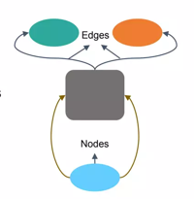
An open source software library for numerical computation that works on the basis of Data Flow Graph that have nodes and edges

Slide 9
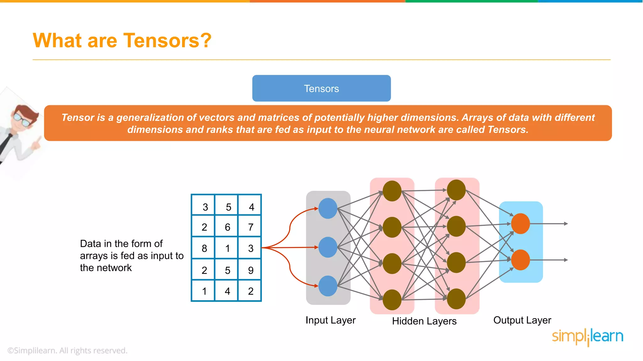

Slide 10
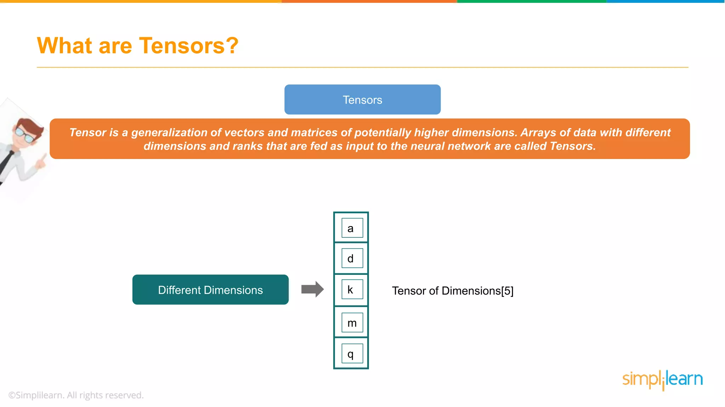

Slide 11
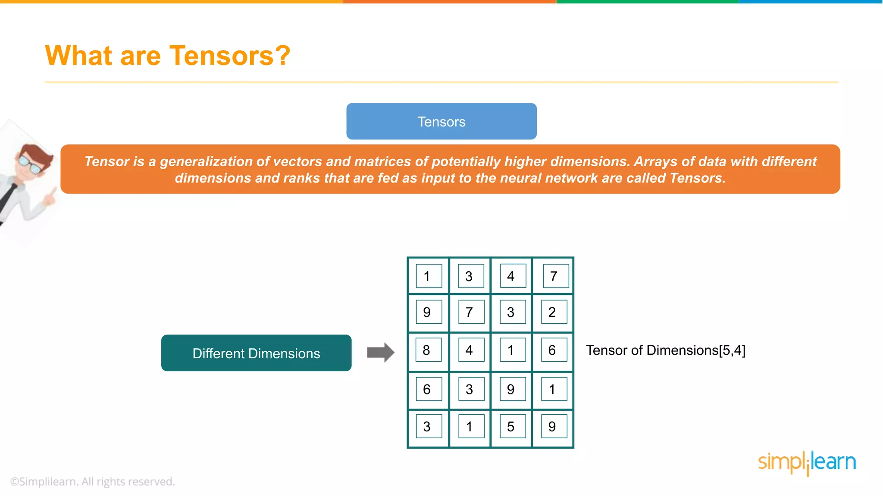

Slide 12
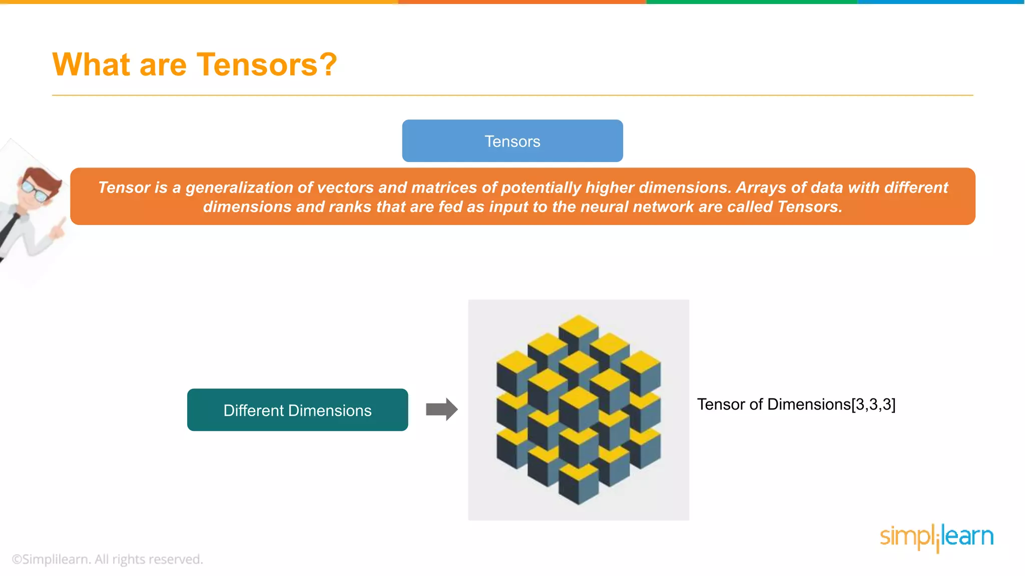

Slide 13
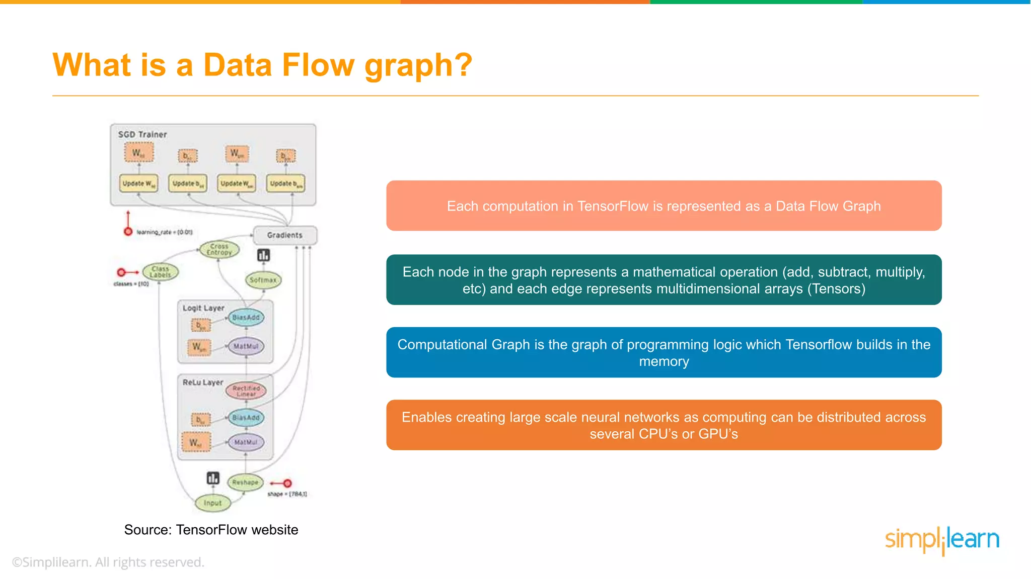

Slide 14
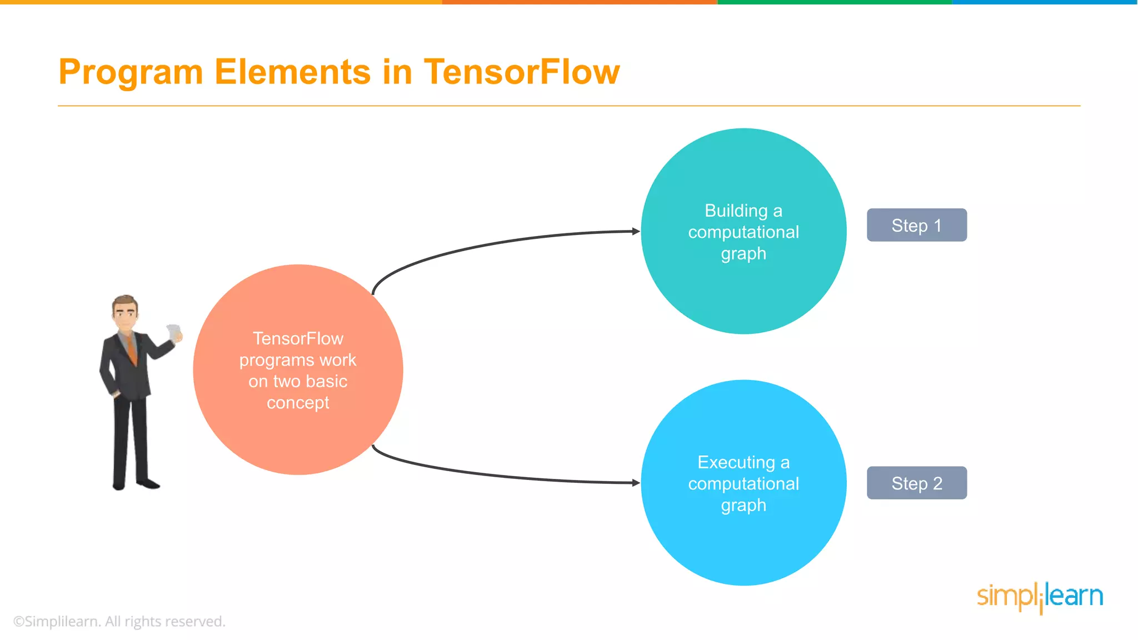

Slide 15
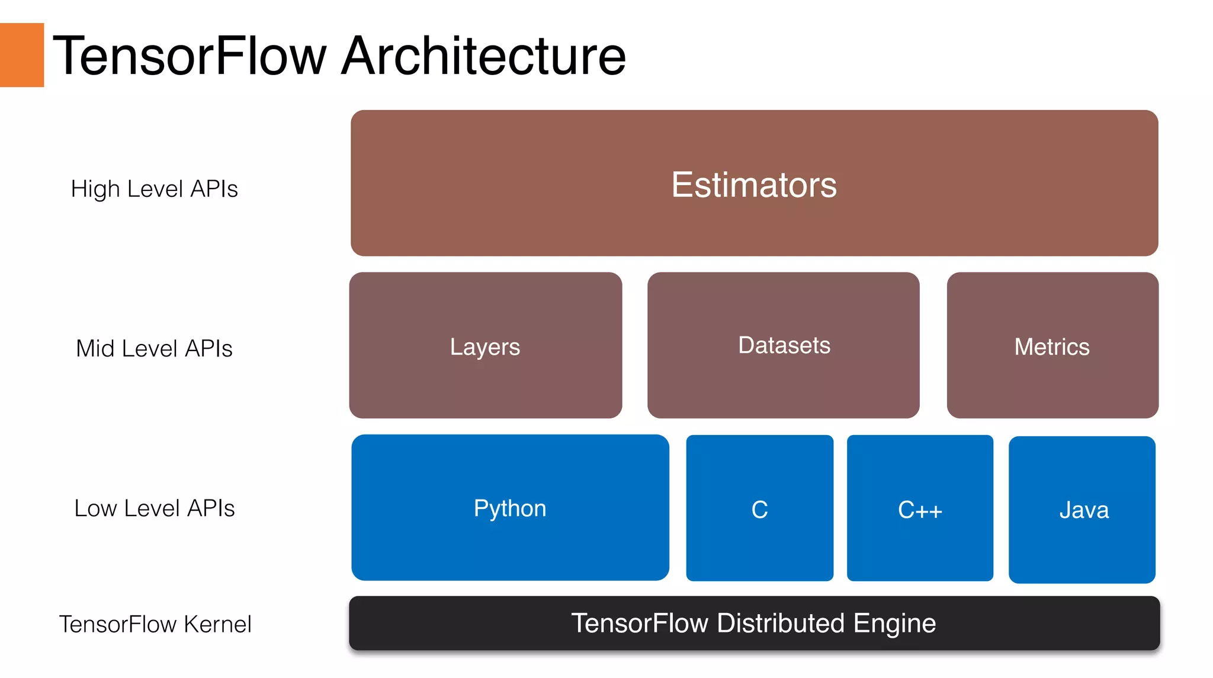

Slide 16
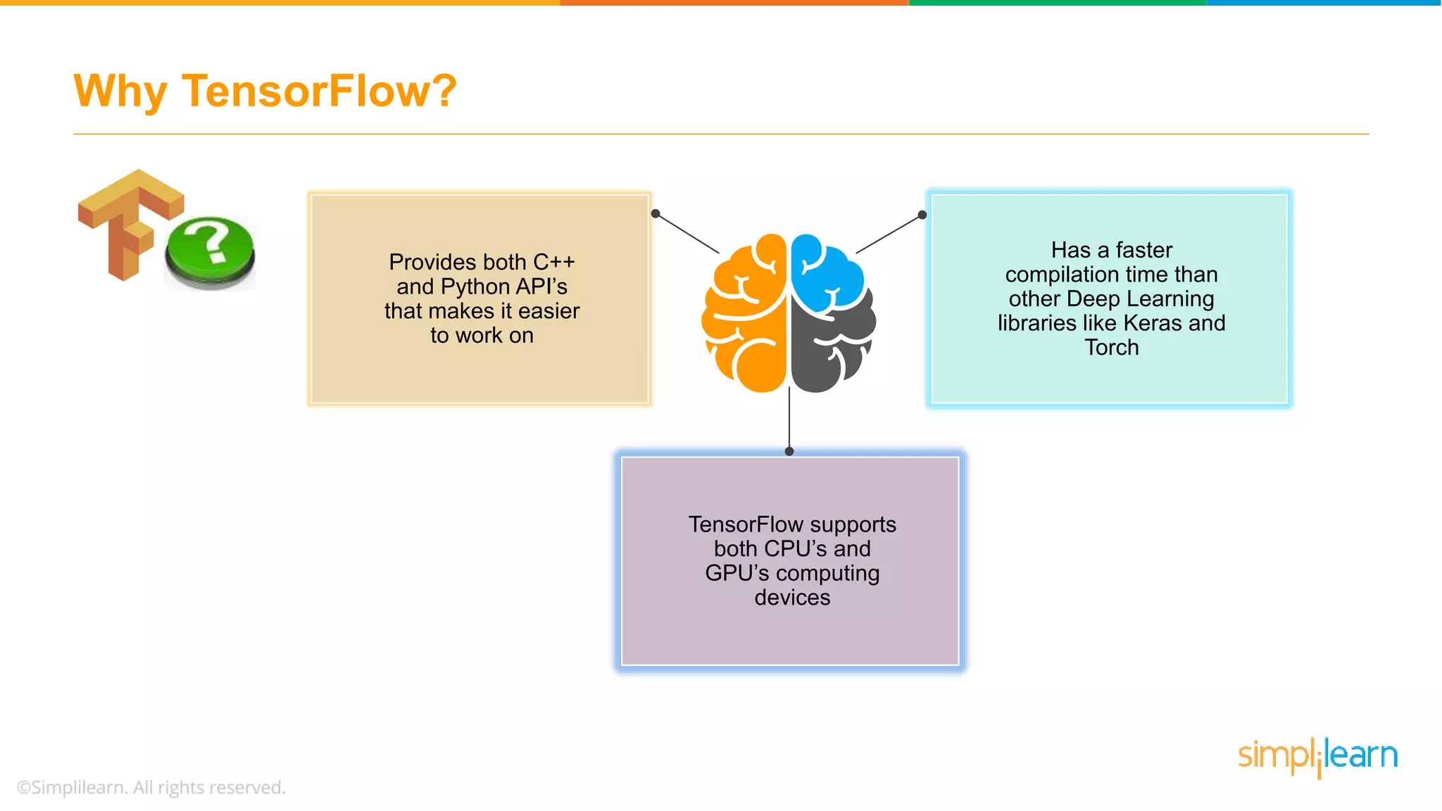
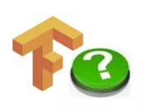

It is open source and backed by a large community of software engineers including google
Provides both C++ and Python API’s that makes it easier to work on
Has a faster compilation time than other Deep Learning Libraries like Torch,etc
TensorFlow supports both CPU’s and GPU’s computing devices
Allows parallel neural networking. Allows batch normalization and optimization of algorithms
Provides the visualization of graph which is not an option with Scikit or NumPy

Slide 17

What is Keras ?
Keras is a High-level neural networks API, Written in Python

Slide 18
What is Keras ?
Keras minimizes the number of user actions required for common use cases, and provides clear and actionable feedback upon user error

Slide 19
What is Keras ?
Allows for easy and fast prototyping (through user friendliness, modularity and extensibility)

Slide 20
What is Keras ?
Supports integration with TensorFlow, Theano and Runs seamlessly on CPU and GPUs

Slide 21
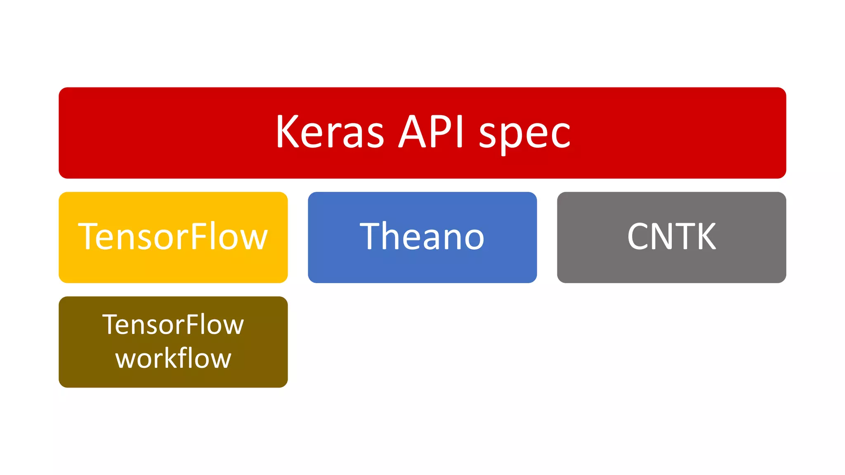
Keras - Architecture

Slide 22
Why Keras ?
Fast prototyping and Supports CNN, RNN and combination of both
Deep enough to build serious models
Has a faster compilation time than other Deep Learning APIs
Supports Modularity and Easy Extensibility
Simple to get started, simple to keep going
Well – written document and runs seamlessly on CPU and GPU

Slide 23
THANK YOU !!

